Slide 1
Cloudera Quickstart VM Setup
https://bit.ly/2T4vcBL

Slide 2
Introduction to the Hadoop Platform Workshop

Slide 3


Robert Sanders
Big Data Manager and Engineer
robert@clairvoyantsoft.com
Satya Mudiam
Engineering Manager
satya@clairvoyantsoft.com
Robert Sanders is an Engineering Manager at Clairvoyant. In his day job, Robert wears multiple hats and goes back and forth between Architecting and Engineering large scale Data platforms. Robert has deep background in enterprise systems, initially working on fullstack implementations and then focusing on building Data Management Platforms.
Passionate about designing and building enterprise solutions using Big Data and Predictive Analytics.

Slide 4





About
Background
Awards & Recognition
Boutique consulting firm centered on building data solutions and products
All things Web and Data Engineering, Analytics, ML and User Experience to bring it all together
Support core Hadoop platform, data engineering pipelines and provide administrative and devops expertise focused on Hadoop

Slide 5
Quick Poll
Notes:
Hadoop
Java
Python
Scala

Slide 6
Documents and Environment Setup
All Workshop Material: https://bit.ly/2SajqBj
Cloudera Quickstart VM Setup: https://bit.ly/2T4vcBL
Slides: https://bit.ly/2SRwHUQ
Exercise Data and Materials: https://bit.ly/2EipK5Y
Exercises: https://bit.ly/2BKCuAG

Slide 7
Workshop Objectives
What is Big Data?
Introduction to HDFS, YARN and MapReduce
Introduction to Apache Sqoop
Introduction to Apache Hive
Introduction to Apache Spark
Introduction to Machine Learning

Slide 8
What is Big Data?

Slide 9
The Age of Data
Over the last few years - the rate of data creation, especially in digital form has exploded
Data is now created in a digital first fashion
Manual processes of yester years have been automated and data is captured digitally
Social Media and Online participation has added to our digital footprint
Transactional, Operational and behavioral data is all around us
Notes:
●Investments over the last couple of decades in automating almost all business processes, document management and other day to day functions have resulted in enterprises now having a large historical dataset on their operations and their customers
Transactions - credit card etc
Operational - servers, system to system interaction, IoT
Behavioral - as we interact with online systems - we leave a trace and a footprint

Slide 10
Big Data
Big Data
More than a single machine can process
100s of GB, TB, PB?!
Why the Buzz now?
Low Storage Costs
Increased Computing power
Potential for Tremendous Insights
Data for Competitive Advantage
Velocity, Variety, Volume

Slide 11
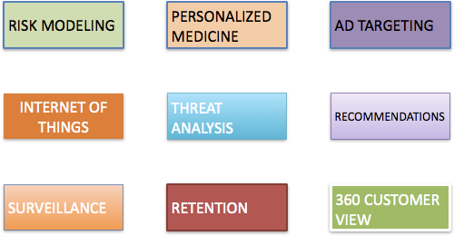
Big Data Use Cases

Slide 12
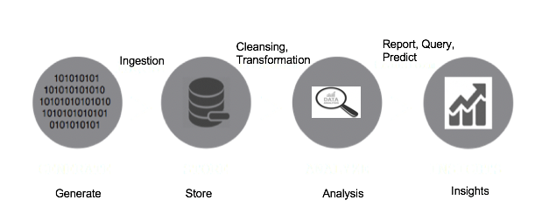
Data Value Chain

Slide 13
Data Becomes the Bottleneck
Moore’s Law has held firm over 40 years
Processing power doubles every two years
Processing speed is no longer the problem
Getting the data to the processors becomes the bottleneck
Quick Math
Typical disk data transfer rate: 75 MB/Sec
Time taken to transfer 100GB of data to the processor? 22 minutes!!
Assuming sustained reads
Actual time will be worse, since most servers have less than 100 GB of RAM

Slide 14
Need for New Approach
Fault Tolerant
System must support partial Failure
Failure of a component should result in a graceful degradation of application performance
If a component of the system fails, the workload needs to be picked up by other components.
Failure should not result in loss of any data
Components should be able to join back upon recovery
Scalable
Increasing resources should support a proportional increase in load capacity.

Slide 15
Apache Hadoop
There are multiple distributed computing platforms, both open source and proprietary
One of the most popular ones is Apache Hadoop
Hadoop was built ground up to address the needs and problems that we just discussed
This workshop is intended to give you an overview of Apache hadoop, in a hands on fashion

Slide 16
Traditional vs Hadoop Approach
Traditional - Send the Data to the Application
Servers
Database Servers Store the Data
Application Servers Process the Data
Data is retrieved from database and sent to application for processing
Can become network and I/O intensive for GBs of data.
Hadoop - Send the Application to the Data
Distribute data onto multiple commodity hardware (data nodes)
Send application to data nodes instead and process data in parallel.

Slide 17
What is Hadoop?
Hadoop is a framework for distributed file system with distributed data processing
The Hadoop Distributed File System (HDFS)
MapReduce
A set of machines running HDFS and MapReduce is known as a Hadoop Cluster
Individual machines are known as Nodes
Data is replicated multiple times on the system for increased availability and reliability
Computation happens where the data is stored
Nodes talk to each other as little as possible
Shared Nothing Architecture
Fault Tolerance

Slide 18

Fun Fact!
Invented by Doug Cutting
Named after his sons Toy Elephant

Slide 19
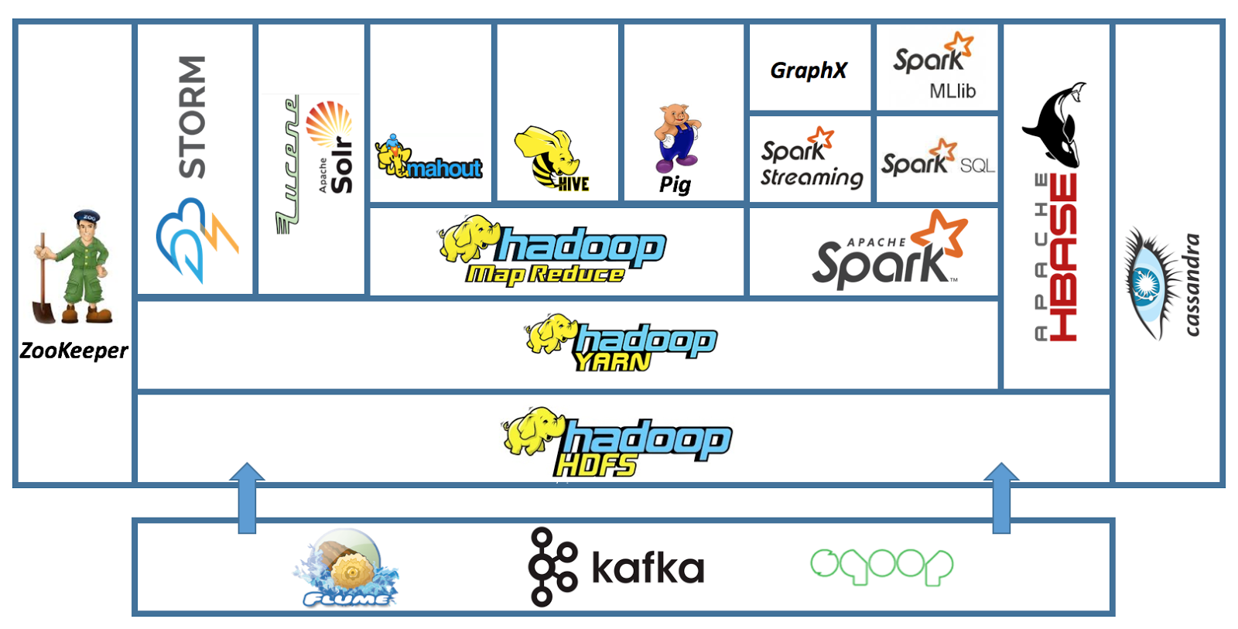
Apache Hadoop - Ecosystem

Slide 20




Focus for Today

Slide 21
Apache Hadoop (HDFS)

Slide 22
HDFS
HDFS is a Distributed File System written in Java
Sits on top of a native filesystem
Such as ext3, ext4 or xfs
Designed for storing very large files with streaming data access patterns
Write-once, read-many-times pattern
No Random writes to files are allowed
High Latency, High Throughput

Slide 23
HDFS Distribution
Files are split into blocks of size 64MB, 128MB or some configurable value
Data is distributed across machines at load time
Blocks are replicated across multiple machines, known as DataNodes
Default replication is 3 times

Slide 24
HDFS Daemons
NameNode
Keeps track of which blocks make up a file and where those blocks are located
Cluster is not accessible without a NameNode
Secondary NameNode
Takes care of housekeeping activities for NameNode (not a backup)
DataNode
Regularly report their status to namenode in a heartbeat
Every hour or at startup sends a block report to NameNode

Slide 25
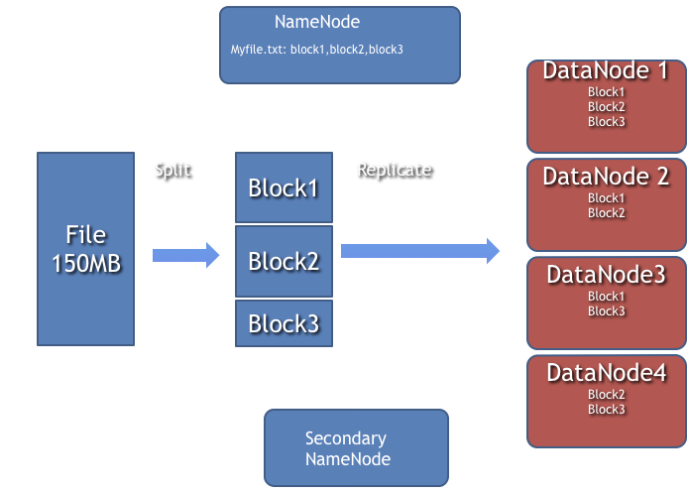
HDFS
Myfile.txt

Slide 26
HDFS CLI CMDS
Access to HDFS from the command line is achieved with the hadoop fs command
File system commands
ls
cat
put
get
Rm
Also accessible via Java APIs

Slide 27
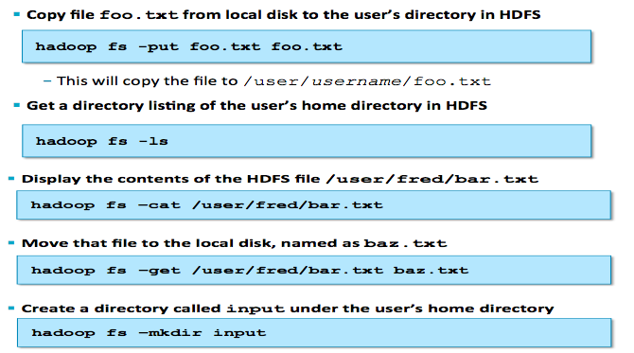
hadoop fs

Slide 28
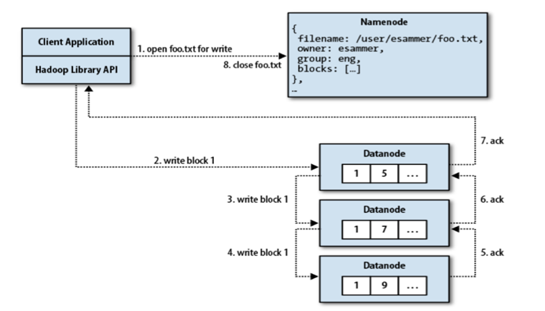
hadoop fs –put

Slide 29
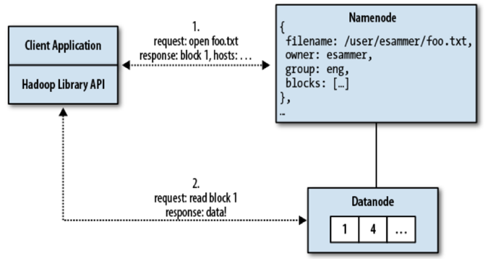
hadoop fs –get

Slide 30
Hands-On: HDFS

Slide 31
MapReduce

Slide 32
MapReduce
OK, You have data in HDFS, what next?
Process the data via MapReduce!
Parallel processing for large amounts of data
Map function, Reduce function
Data Locality
Code is shipped to the node closest to data
Java, Python, Ruby, Scala and more

Slide 33
MapReduce Features
Automatic parallelization and distribution
Fault-tolerance
Status and monitoring tools
Clean abstraction for programmers
MapReduce programs usually written in Java (Hadoop Streaming)
Abstracts all the housekeeping activities from developers

Slide 34
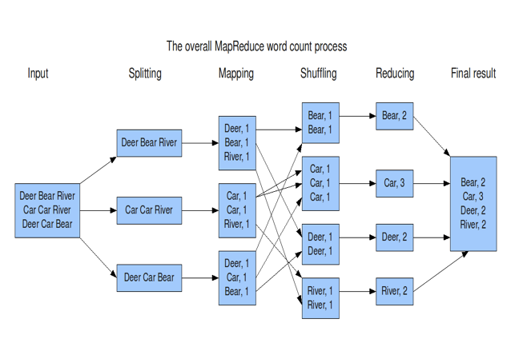
WordCount MapReduce

Slide 35
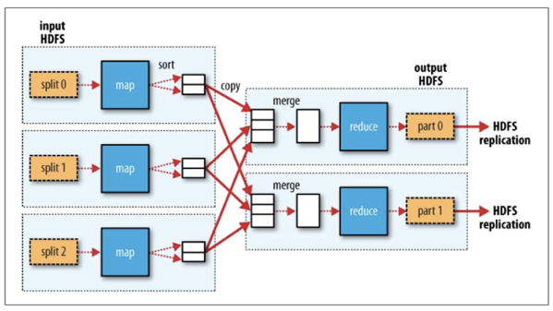
MapReduce

Slide 36
YARN
Yet Another Resource Negotiator
The fundamental building block to provide distributed compute oriented services across all of Hadoop
Imagine a typical Operating System, it serves multiple needs:
Coordinates the execution of various applications
Provides time slicing to give the appearance of multiple applications running at the same time
Developers can write applications and the Operating system can handle the execution of those applications
In a distributed environment – there are multiple machines that form a cluster
Across these machines – there is an aggregate amount of processors (CPUs) and memory (RAM) that is available

Slide 37
Main Daemons
HDFS
DataNode
NameNode
MapReduce 1.0
TaskTracker
JobTracker
MapReduce 2.0
Nodemanager
ResourceManager

Slide 38
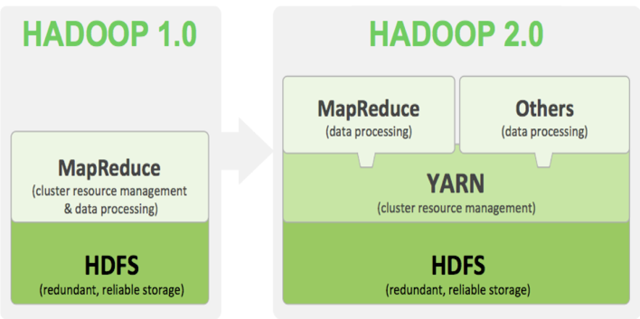
Hadoop 2.0
Notes:
MR1
only MapReduce
aka - batch mode
MR2
YARN based
MR is one implementation on top of YARN
batch, interactive, online, streaming…. Many other use cases possible

Slide 39
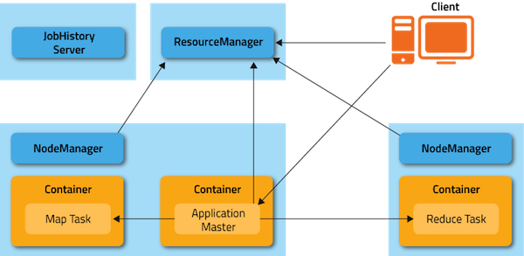
MapReduce job on YARN

Slide 40
How do you write MapReduce?
MapReduce is a basic building block, programming approach to solve larger problems
In most real world applications, multiple MR jobs are chained together
Processing pipeline - the output of one job becomes the input to another job

Slide 41
Hands-On: MapReduce

Slide 42
Apache Sqoop

Slide 43
Background
While Hadoop can power multiple use cases, here are some of the main capabilities it provides
Serves as an archive and allows the offload of data storage from transactional systems
Serves as a platform that allows the large scale transformation of data from one structure to another
Can allow query over entire datasets – without the need for sampling
But Hadoop is typically not the place where all this data is created or generated.

Slide 44

Typical Enterprise Data Landscape
And dozens of other
databases …..
CRM
Sales
Billing
ERP

Slide 45
Problem Statement
Since Data is typically generated in all these source systems,
How can I enable transfer of data, to and from database systems and Hadoop???
and How can I do this in fast, continuous and reliable fashion?

Slide 46
What is Apache Sqoop?
Apache Sqoop is the sub-project within Apache Hadoop that provides the ability to transfer data in and out of Hadoop
You can use it to import data from a RDBMS such as SQL Server, MySQL, Oracle, etc into HDFS
Sqoop also allows you to export data from HDFS back into RDBMS
Sqoop provides lots of options to do this at scale, in a fast and parallel fashion
Sqoop uses MapReduce and YARN to run on the Hadoop Cluster
It runs in a distributed fashion – by using mappers to split the data that needs to be copied
After it reads records from a RDBMS – it writes them out to a HDFS file

Slide 47
Command Line Interface (CLI)
Utilize the sqoop command:
$ sqoop help
$ sqoop version
$ sqoop import ...
$ sqoop export ...
$ sqoop eval ...
more...

Slide 48
Simple Import
import: One of the commands sqoop supports. Provides capability to copy data from RDBMS to HDFS
--connect: takes a JDBC connection string that points to source data
--username and --password: Credentials required to login to the database
--table: The table from the source RDBMS that we want to intest
--num-mappers: Number of Mapper tasks to spawn within the MapReduce Job
--target-dir: Location in HDFS to save the data extracted from the RDBMS
$ sqoop import \
--connect jdbc:mysql://{HOST}/{DATABASE_NAME} \
--username {USERNAME} \
--password {PASSWORD} \
--table {TABLE_NAME} \
--num-mappers {NUMBER_OF_MAPPERS} \
--target-dir {TARGET_HDFS_PATH}

Slide 49
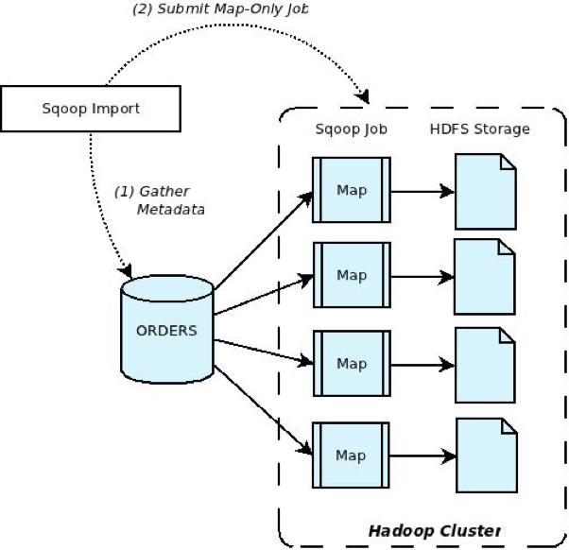
Behind the Scenes
Step 1: Introspects the database based on config provided and generates a plan (metadata) to import the data
Step 2: Executes a Map-Only job to then perform the data transfer based on the plan generated in Step 1

Slide 50
Apache Sqoop
It provides a lot more options than the ones we have covered, but the key concept to keep in mind is that it powers data transfer across RDBMS and the cluster
To Date, it is one of the primary mechanisms to import data into the cluster in even large enterprises
While by default Sqoop will import into HDFS – it can also import data directly into a Hive table, (depending on time – we may cover that later today)
Sqoop will work with any database that has a JDBC connector (almost all databases)

Slide 51
Hands-On: Sqoop

Slide 52
Apache Hive

Slide 53
Requirements for MapReduce
MapReduce code is typically written in Java
Requires:
A good java programmer
Who understands MapReduce
Who understands the problem
Who will be available to maintain and update the code in the future as requirements change

Slide 54
The Difficulties
Many organizations have only a few developers who can write good MapReduce code
Many other people want to analyze data
Business analysts
Data scientists
Statisticians
Data analysts
Need a higher level abstraction on top of MapReduce
Ability to query the data without needing to know MapReduce intimately
Hive addresses these needs

Slide 55

Hive

Slide 56
Hive
Abstraction on top of MapReduce
Allows users to query data in the Hadoop cluster without knowing Java or MapReduce
Uses HiveQL Language
Very Similar to SQL
Hive Interpreter runs on a client machine
Turns HiveQL queries into MapReduce jobs
Submits those jobs to the cluster
Data within Hadoop can now represented as Tables and Views

Slide 57
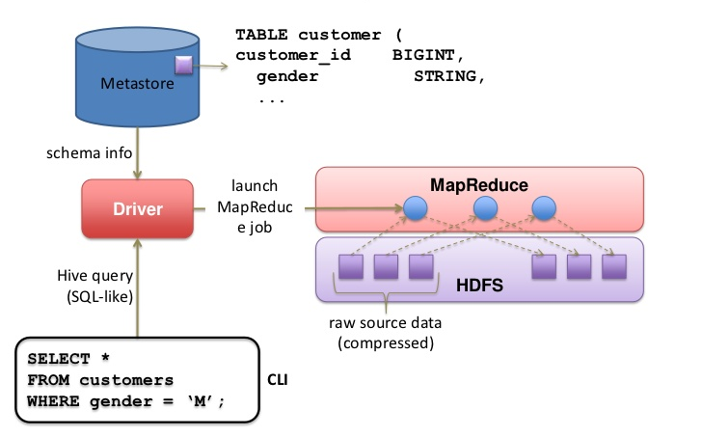
Hive Execution

Slide 58
Hive Data Model
Hive ‘layers’ table definitions on top of data in HDFS
Tables
Typed columns
TINYINT , SMALLINT, INT, BIGINT
FLOAT, DOUBLE
STRING
BINARY, BOOLEAN
TIMESTAMP
ARRAY , MAP, STRUCT

Slide 59
Hive Daemon
Hive Metastore
A database containing table definitions and other metadata
By default, stored locally on the client machine in a Derby database
Usually MySQL if the metastore needs to be shared across multiple people
Table definitions on top of data in HDFS

Slide 60
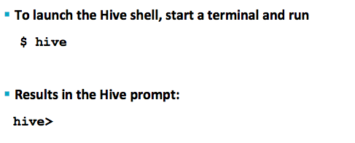
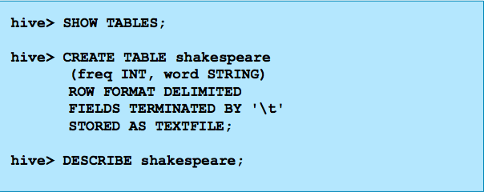
Hive Examples

Slide 61
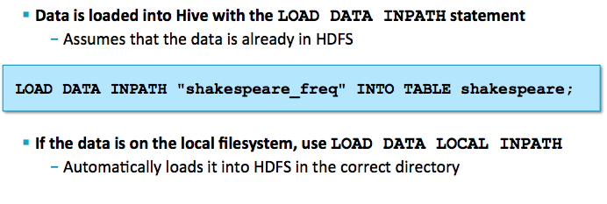
Hive Examples

Slide 62
Hive Limitations
Not all ‘standard’ SQL is supported
Subqueries are only supported in the FROM clause
No correlated subqueries
Limited support for UPDATE or DELETE
More

Slide 63
Hands-On: Hive

Slide 64
Apache Spark

Slide 65
What is Apache Spark?
Open source data processing engine that runs on a cluster
https://github.com/apache/spark
Primarily written in Scala
Provides a number of Libraries for Batch, Streaming and other forms of processing
Very fast in memory processing engine
Support for Java, Scala, Python, and R

Slide 66
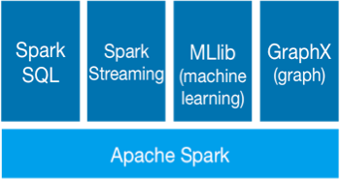
Apache Spark EcoSystem
Apache Spark
RDDs
Spark SQL
Once known as “Shark” before completely integrated into Spark
For SQL, structured and semi-structured data processing
Spark Streaming
Processing of live data streams
MLlib/ML
Machine Learning Algorithms
GraphX
Graph Processing
Apache Spark, Apache Spark Ecosystem
http://spark.apache.org/images/spark-stack.png

Slide 67
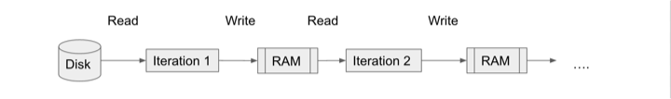
MapReduce Bottlenecks and Improvements
Bottlenecks
MapReduce is a very I/O heavy operation
Map phase needs to read from disk then write back out
Reduce phase needs to read from disk and then write back out
How can we improve it?
RAM is becoming very cheap and abundant
Use RAM for in-data sharing

Slide 68
MapReduce vs. Spark (Performance) (Cont.)
Dayton Gray 100 TB sorting results
https://databricks.com/blog/2014/10/10/spark-petabyte-sort.html
 | MapReduce Record | Spark Record | Spark Record 1PB
Data Size | 102.5 TB | 100 TB | 1000 TB
# Nodes | 2100 | 206 | 190
# Cores | 50400 physical | 6592 virtualized | 6080 virtualized
Elapsed Time | 72 mins | 23 mins | 234 mins
Sort rate | 1.42 TB/min | 4.27 TB/min | 4.27 TB/min
Sort rate/node | 0.67 GB/min | 20.7 GB/min | 22.5 GB/min

Slide 69
Running Spark Jobs
Shell
Shell for running Scala Code
$ spark-shell
Shell for running Python Code
$ pyspark
Shell for running R Code (If the Libraries are distributed)
$ sparkR
Submitting (Java, Scala, Python, R)
$ spark-submit --class {MAIN_CLASS} [OPTIONS] {PATH_TO_FILE} {ARG0} {ARG1} … {ARGN}

Slide 70
Apache Spark
RDD API

Slide 71
SparkContext
A Spark program first creates a SparkContext object
Spark Shell automatically creates a SparkContext as the sc variable
Tells spark how and where to access a cluster
Use SparkContext to create RDDs
Documentation
https://spark.apache.org/docs/latest/api/scala/index.html#org.apache.spark.SparkContext

Slide 72
SparkContext (Creation)
Python
from pyspark import SparkConf, SparkContext
conf = SparkConf().setMaster("local").setAppName("My App")
sc = SparkContext(conf = conf)
Scala
import org.apache.spark.SparkConf
import org.apache.spark.SparkContext
import org.apache.spark.SparkContext._
val conf = new SparkConf().setMaster("local").setAppName("My App")
val sc = new SparkContext(conf)
Java
import org.apache.spark.SparkConf;
import org.apache.spark.api.Java.JavaSparkContext;
SparkConf conf = new SparkConf().setMaster("local").setAppName("My App");
JavaSparkContext sc = new JavaSparkContext(conf);

Slide 73
RDDs
Primary abstraction object used by Apache Spark
Resilient Distributed Dataset
Fault-tolerant
Collection of elements that can be operated on in parallel
Distributed collection of data from any source
Contained in an RDD:
Set of partitions
Atomic pieces of a dataset
Set of dependencies on parent RDDs
Lineage (Directed Acyclic Graph - DAG)
A function for computing the RDD based on its parents
Metadata about its partitioning scheme and data placement

Slide 74
RDDs (Cont.)
RDDs are Immutable
Allows for more effective fault tolerance
Intended to support abstract datasets while also maintain MapReduce properties like automatic fault tolerance, locality-aware scheduling and scalability.
Built to resemble the Scala Collections API
Programming Guide
http://spark.apache.org/docs/latest/quick-start.html

Slide 75
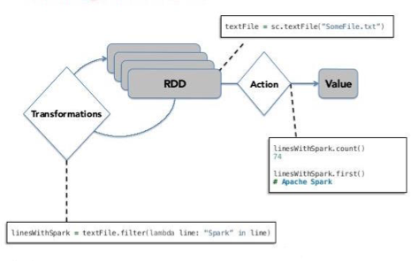
RDDs (Cont.)
Lazy Evaluation
Waits for action to be called before distributing tasks to worker nodes
Surendra Pratap Singh - To The New, Working with RDDs
http://www.tothenew.com/blog/wp-content/uploads/2015/02/580x402xSpark.jpg.pagespeed.ic.KZMzgXwkwB.jpg

Slide 76
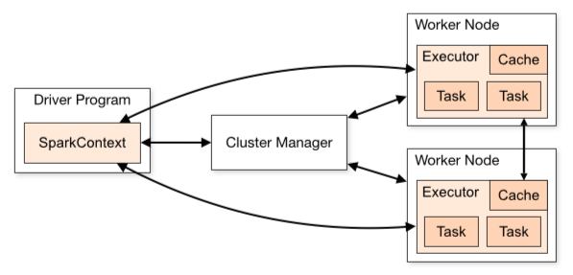
Spark Architecture
Apache Spark, Cluster Mode Overview
http://spark.apache.org/docs/latest/img/cluster-overview.png

Slide 77
Create RDD
Can only be created using the SparkContext or by adding a Transformation to an existing RDD
Using the SparkContext:
Parallelized Collections – take an existing collection and run functions on it in parallel
rdd = sc.parallelize([ "some", "list", "to", "parallelize"], [numTasks])
File Datasets – run functions on each record of a file in Hadoop distributed file system or any other storage system supported by Hadoop
rdd = sc.textFile("/path/to/file", [numTasks])
rdd = sc.objectFile("/path/to/file", [numTasks])

Slide 78
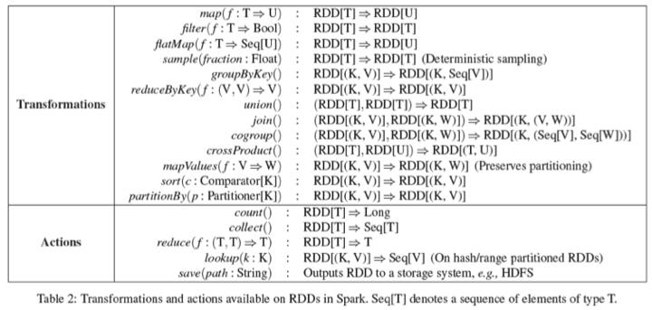
API (Overview)
Berkely.edu, Transformations and Actions
http://www.eecs.berkeley.edu/Pubs/TechRpts/2011/EECS-2011-82.pdf

Slide 79
Word Count Example
Scala
val textFile = sc.textFile("/path/to/file.txt")
val counts = textFile
.flatMap(line => line.split(" "))
.map(word => (word, 1))
.reduceByKey(_ + _)
counts.saveAsTextFile("/path/to/output")
Python
text_file = sc.textFile("/path/to/file.txt")
counts = text_file
.flatMap(lambda line: line.split(" "))\
.map(lambda word: (word, 1))\
.reduceByKey(lambda a, b: a + b)
counts.saveAsTextFile("/path/to/output")

Slide 80
Word Count Example (Java 7)
JavaRDD<String> textFile = sc.textFile("/path/to/file.txt");
JavaRDD<String> words = textFile.flatMap(new FlatMapFunction<String, String>() {
public Iterable<String> call(String line) {
return Arrays.asList(line.split(" "));
}
});
JavaPairRDD<String, Integer> pairs = words.mapToPair(new PairFunction<String, String, Integer>() {
public Tuple2<String, Integer> call(String word) {
return new Tuple2<String, Integer>(word, 1);
}
});
JavaPairRDD<String, Integer> counts = pairs.reduceByKey(new Function2<Integer, Integer, Integer>() {
public Integer call(Integer a, Integer b) {
return a + b;
}
});
counts.saveAsTextFile("/path/to/output");

Slide 81
Word Count Example (Java 8)
JavaRDD<String> textFile = sc.textFile("/path/to/file.txt");
JavaPairRDD<String, Integer> counts = lines
.flatMap(line -> Arrays.asList(line.split(" ")));
.mapToPair(w -> new Tuple2<String, Integer>(w, 1))
.reduceByKey((a, b) -> a + b);
counts.saveAsTextFile("/path/to/output");

Slide 82
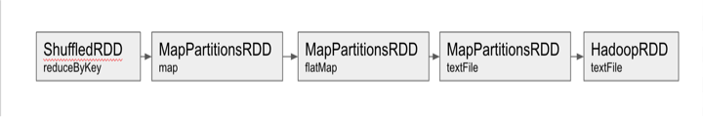
RDD Lineage Graph
val textFile = sc.textFile("/path/to/file.txt")
val counts = textFile.flatMap(line => line.split(" "))
.map(word => (word, 1))
.reduceByKey(_ + _)
counts.toDebugString
res1: String =
(1) ShuffledRDD[7] at reduceByKey at <console>:23 []
+-(1) MapPartitionsRDD[6] at map at <console>:23 []
| MapPartitionsRDD[5] at flatMap at <console>:23 []
| /path/to/file.txt MapPartitionsRDD[3] at textFile at <console>:21 []
| /path/to/file.txt HadoopRDD[2] at textFile at <console>:21 []

Slide 83
Fault Tolerance
RDDs contain lineage graphs (coarse grained updates/transformations) to help it rebuild partitions that were lost
Only the lost partitions of an RDD need to be recomputed upon failure.
They can be recomputed in parallel on different nodes without having to roll back the entire app
Also lets a system tolerate slow nodes (stragglers) by running a backup copy of the troubled task.
Original process on straggling node will be killed when new process is complete
Cached/Check pointed partitions are also used to re-compute lost partitions if available in shared memory

Slide 84
Apache Spark
SQL

Slide 85
Spark SQL
Spark module for structured data processing
The most popular Spark Module in the Ecosystem
It is highly recommended to use this the DataFrames (Dataset API) over RDDs because of the performance benefits
Catalyst Optimizer
Project Tungsten
Runs SQL/HiveQL Queries, optionally alongside or replacing existing Hive deployments
Use SQLContext to perform operations
White Paper
http://people.csail.mit.edu/matei/papers/2015/sigmod_spark_sql.pdf
Programming Guide:
https://spark.apache.org/docs/latest/sql-programming-guide.html

Slide 86
SQLContext
Used to Create DataFrames and Datasets
Spark Shell automatically creates a SparkContext as the sqlContext variable
Implementations
SQLContext
HiveContext
An instance of the Spark SQL execution engine that integrates with data stored in Hive
As of Spark 2.0 use SparkSession
https://spark.apache.org/docs/latest/api/scala/index.html#org.apache.spark.sql.SparkSession

Slide 87
DataFrame API
A distributed collection of rows organized into named columns
You know the names of the columns and data types
Unlike RDDs, DataFrame’s keep track of their schema and support various relational operations that lead to more optimized execution
Like Pandas and R

Slide 88
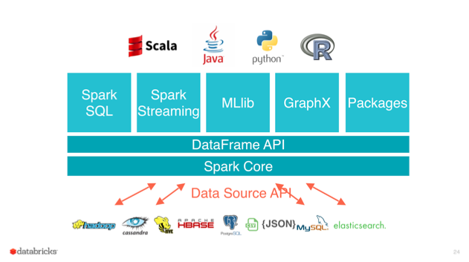
DataFrame API (Cont.)
ogirardot blog, DataFrames API
https://ogirardot.wordpress.com/2015/05/29/rdds-are-the-new-bytecode-of-apache-spark/

Slide 89
DataFrame Reader and Writer
Based off user feedback, the developers created a more fluid set of APIs
Reading Data
SQLContext.read
Writing Data
DataFrame.write

Slide 90
DataFrame Reader (Defining DataFrames)
Scala
val df = sqlContext.read...
Python
df = sqlContext.read…
Java
import org.apache.spark.sql.DataFrame;
DataFrame df = sqlContext.read()...;

Slide 91
DataFrame Reader
Predefined Formats
val df = sqlContext.read.table(“table_name”)
val df = sqlContext.read.json(“/path/to/file.json”)
val df = sqlContext.read.parquet(“/path/to/file.parquet”)
val df = sqlContext.read.text(“/path/to/file.txt”)
Dynamic Formats
val df = sqlContext.read.format(”jdbc”).option(Map("url" -> "jdbc:postgresql:dbserver", "dbtable" -> "schema.tablename")).load()
val df = sqlContext.read.format(”com.databricks.spark.csv”).load(“/path/to/file.csv”)

Slide 92
DataFrame API (SQL Queries)
One use of Spark SQL is to execute SQL queries written using either a basic SQL syntax or HiveQL
Scala
val df = sqlContext.sql(”<SQL>”)
Python
df = sqlContext.sql(”<SQL>”)
Java
DataFrame df = sqlContext.sql(”<SQL>");

Slide 93
Registering DataFrames as Views
val df = sqlContext.read.json(“/path/to/file.json”)
df.registerTempTable(“temp_json_table”)
val newDf = sqlContext.sql(“SELECT * FROM temp_json_table”)

Slide 94
DataFrame Operations
Print Schema
df.printSchema()
Filter Data
val newDf = df.where(“col1 = ‘some_value”)
val newDf = df.filter(“col1 = ‘some_value AND col2 = ‘another_value’”)
Select Specific Columns
val newDf = df.select(“col1”, “col2”)
Show
df.show()
Count
val count = df.count()
Many More

Slide 95
DataFrame Operations (Joins)
join(right: DataFrame): DataFrame
Cartesian join with another DataFrame.
join(right: DataFrame, usingColumn: String): DataFrame
Inner equi-join with another DataFrame using the given column.
join(right: DataFrame, usingColumns: Seq[String]): DataFrame
Inner equi-join with another DataFrame using the given columns.
join(right: DataFrame, usingColumns: Seq[String], joinType: String): DataFrame
Equi-join with another DataFrame using the given columns.
join(right: DataFrame, joinExprs: Column, joinType: String): DataFrame
Join with another DataFrame, using the given join expression.
join(right: DataFrame, joinExprs: Column): DataFrame
Inner join with another DataFrame, using the given join expression.

Slide 96
DataFrame Operations (Joins)
val df1 = sqlContext.read.json(“/path/to/file1.json”)
val df2 = sqlContext.read.json(“/path/to/file2.json”)
// Cartesian Product
val joinDf = df1.join(df2)
// Inner Join on a common “id” column
val joinDf = df1.join(df2, “id”)
// Inner Join on multiple common columns
val joinDf = df1.join(df2, List(“id1”, “id2”), “inner”)
// Inner Join on uncommon “id” columns
val joinDf = df1.join(df2, $”df1_id” === $”df2_id”, “inner”)

Slide 97
DataFrame Operations (Joins with SQL)
val df1 = sqlContext.read.json(“/path/to/file1.json”)
df1.registerTempTable(“df1_table”)
val df2 = sqlContext.read.json(“/path/to/file2.json”)
df2.registerTempTable(“df2_table”)
val joinDf = sqlContext.sql(“SELECT * FROM df1_table df1 JOIN df2_table df2 ON df1.id=df2.id”)

Slide 98
DataFrame Writer
Predefined Formats
df.write.table(“table_name”)
df.write.json(“/path/to/file.json”)
df.write.parquet(“/path/to/file.parquet”)
df.write.text(“/path/to/file.txt”)
Dynamic Formats
df.write.format(”jdbc”).option(Map("url" -> "jdbc:postgresql:dbserver", "dbtable" -> "schema.tablename")).save()
df.write.format(”com.databricks.spark.csv”).save(“/path/to/file.csv”)

Slide 99
DataFrame Writer (SaveMode)
When saving the contents of a DataFrame, you can specify the SaveMode by including the mode(”mode”) function
df.write.mode(”overwrite”).table(“table_name”)
Mode | Description
“error” (default) | When saving a DataFrame to a data source, if data already exists, an exception is expected to be thrown.
“append” | When saving a DataFrame to a data source, if data already exists, an exception is expected to be thrown.
“overwrite” | Overwrite mode means that when saving a DataFrame to a data source, if data/table already exists, existing data is expected to be overwritten by the contents of the DataFrame.
“ignore” | Ignore mode means that when saving a DataFrame to a data source, if data already exists, the save operation is expected to not save the contents of the DataFrame and to not change the existing data. This is similar to a CREATE TABLE IF NOT EXISTS in SQL.

Slide 100
Hands-On: Spark

Slide 101
Machine Learning

Slide 102
Problem Statement
Predict if a patient is going to be readmitted within 30 days of discharge

Slide 103
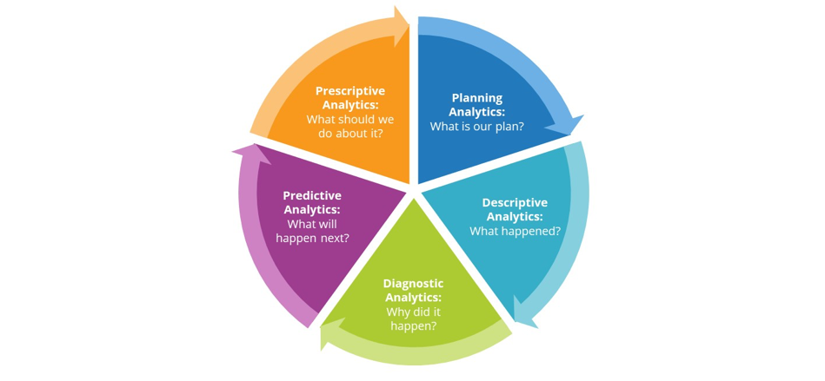
Analytics LifeCycle
IBM

Slide 104
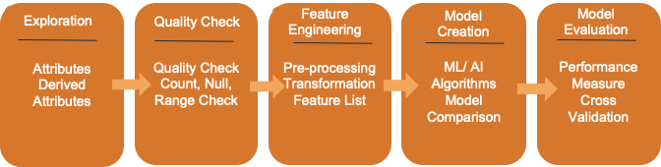
Data Science Life Cycle

Slide 105
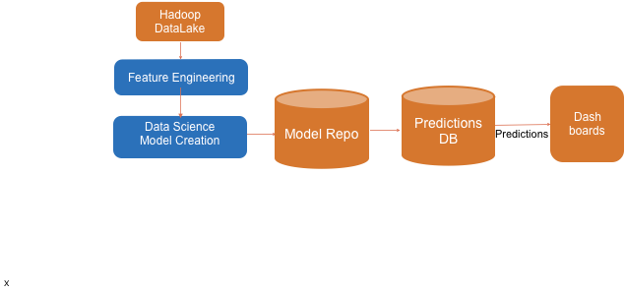
General Architecture

Slide 106
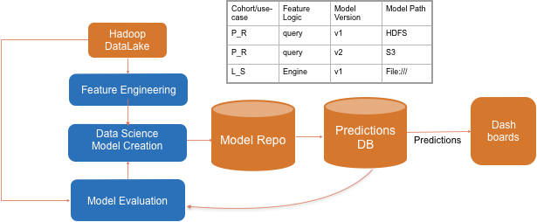
Real World

Slide 107
Featurization
Transformers - Transforms data by adding a new column.
time_in_hospital_binarizer = Binarizer(threshold=4, inputCol="time_in_hospital", outputCol='time_in_hospital_binarized' )
time_in_hospital_binarizer.transform(pr_df).select("time_in_hospital", "time_in_hospital_binarized")
Estimators - Learns from data with .fit() and returns a model. We call transform() on the model to transform data.
gender_indexer = StringIndexer(inputCol = "gender", outputCol="gender_index")
gender_uniqueDf = pr_df.select("gender").distinct()
gender_indexerModel = gender_indexer.fit(gender_uniqueDf)
gender_indexedDf = gender_indexerModel.transform(gender_uniqueDf)
Pipeline - Wraps together the stages in Featurization that includes transformers, estimators etc
pipeline = Pipeline(stages = [
time_in_hospital_binarizer,
gender_indexer,
gender_encoder])

Slide 108
Code Walkthrough

Slide 109
Environment Setup
Mac:
https://medium.com/@jayasagar/start-jupyter-to-work-with-spark-ml-6e68bbcd8b45
Windows:
https://medium.com/@GalarnykMichael/install-spark-on-windows-pyspark-4498a5d8d66c

Slide 110
Thank You!
careers.canada@clairvoyantsoft.com

